Slide 1
EZViz
Parallel Bargram Visualization
By Team D Michael DiCicco Abdullah Al Faysal Daniel Eddings (remote)
Notes:
Daniel will be available remotely through Blackboard during the presentation for any questions, etc. as per the project requirements.

Slide 2
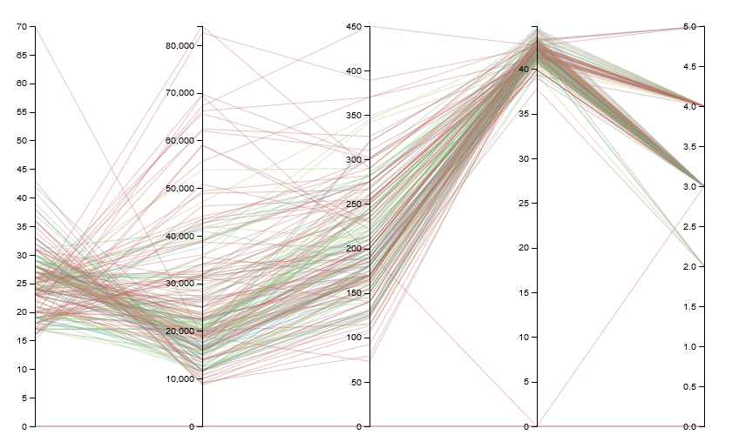
Not EZ
Notes:
May have a separate slide to show visual variables in EZViz Potential issues/solutions concerning data-ink ratio (like too much vertical space): https://www.edwardtufte.com/bboard/q-and-a-fetch-msg?msg_id=000076
https://www.onepager.com/community/blog/renowned-graphics-expert-tufte-still-thinks-our-project-charts-are-mediocre/

Slide 3
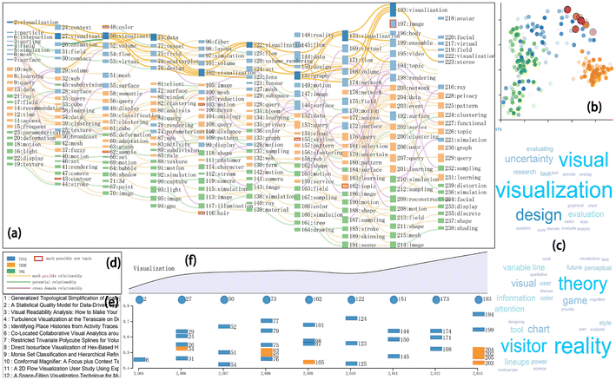
Not EZ
Jiang & Zhang, A text visualization method for cross-domain research topic mining, 2016

Slide 4
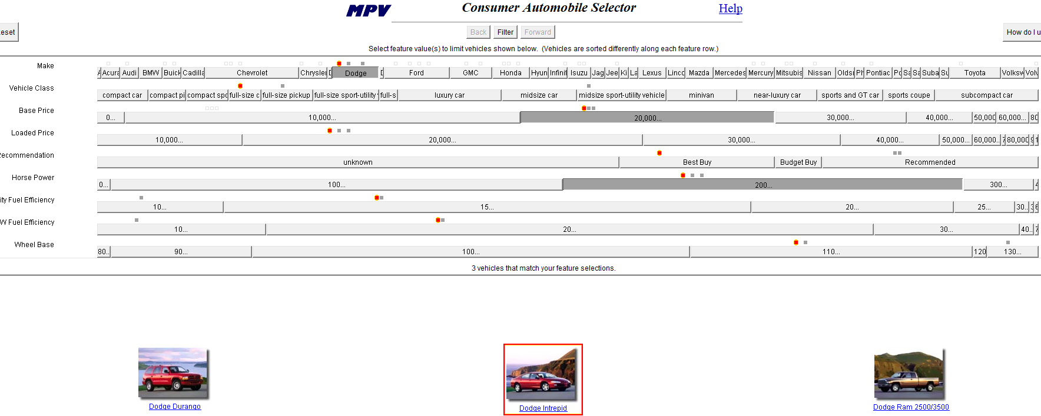
EZChooser “Copyright © 2000 Verizon Laboratories Inc. All rights reserved.”
Notes:
EZChooser was a product of Verizon Labs. Not open source: “All rights reserved.”

Slide 5
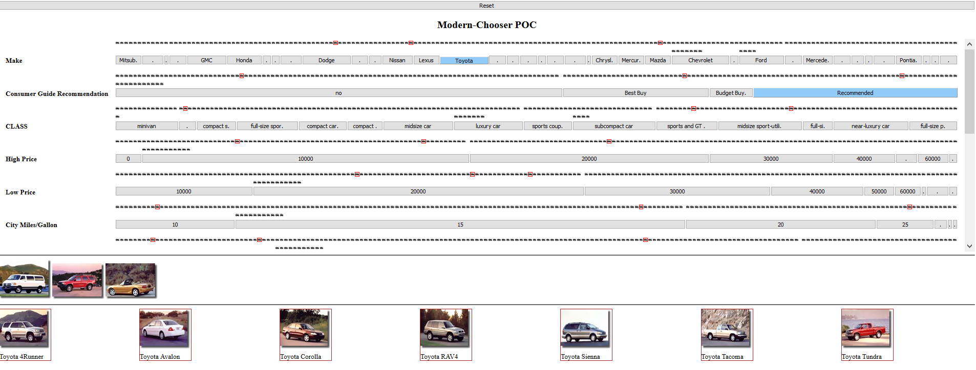

Slide 6
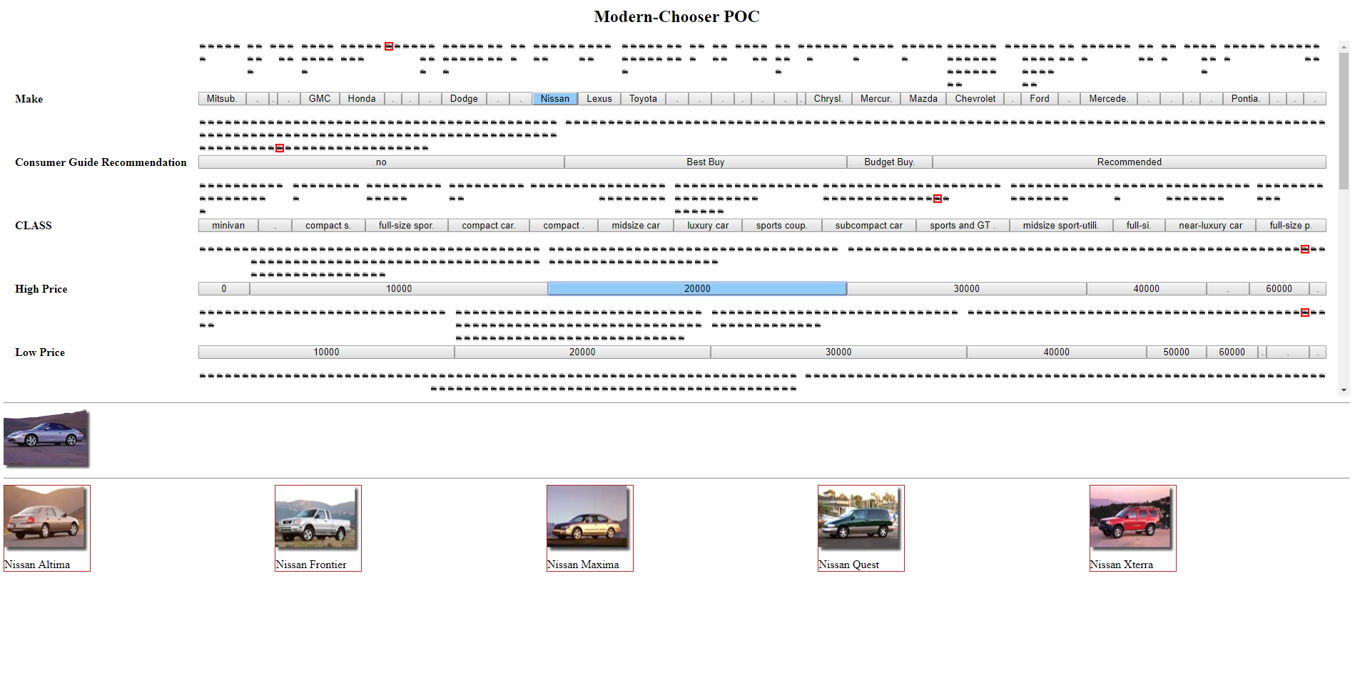

Slide 7
Problem to Solve
Selecting among 10+ attributes
Showing variety while mitigating complexity

Slide 8
Cognitive Economy
Cognitive economy seeks to reduce both the amount of "extraneous" information that the user must manipulate and store in the working memory, and the number and complexity of tasks related solely to the animation.
ME Tudoreanu. (2002) Economy of Interaction in Program Visualization: Designing Effective Visualization Tools for Reducing User's Cognitive Effort
Notes:
Direct quote from Dr. Edi’s PhD thesis.

Slide 9
EZChooser
Easy to compare objects directly
Data-ink ratio is high/good:
Combines unit visualization & aggregated visualization
Features Bertin’s visual variables (position, size, shape, etc)
Limited to < 2,000 items in data set (1080p resolution is 1,920 pixels)
Notes:
As per the EZChooser paper, 1 pixel can represent 1 data point. Need additional pixels for labels and gaps.
May have a separate slide to show visual variables in EZViz Potential issues/solutions concerning data-ink ratio (like too much vertical space): https://www.edwardtufte.com/bboard/q-and-a-fetch-msg?msg_id=000076
https://www.onepager.com/community/blog/renowned-graphics-expert-tufte-still-thinks-our-project-charts-are-mediocre/

Slide 10
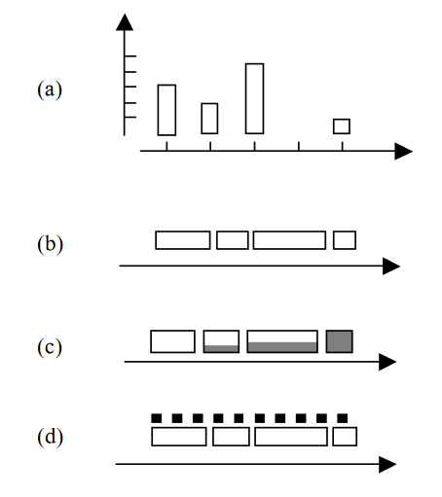
Vocabulary
Bargram: Histogram bars put horizontally end-to-end
Item vectors above bargrams in (d)
Wittenburg et al, Parallel Bargrams for Consumer-based Information Exploration and Choice, 2001
Notes:
Bargrams do not have to have item vectors.

Slide 11
EZChooser
Works Great
Not Widely Available
$$$
Simple, intuitive interface
See-as-you-go visualization
Released in 2000
Needs an old browser like Opera 8 installed along with JDK 2
Java applet with outdated look
A similar commercial product, InfoZoom, is expensive

Slide 12
Viz Features
Unit
Aggregated
Filtering
Glyphs as units
Provides: “Intuition, perception, constructivism & physicality, interaction” (Park, et al. ATOM: A Grammar for Unit Visualizations, 2019)
Bargrams
Helps with scaling issues
7 +/- 2 bins per row
Selects objects that meet criteria
Union (OR) horizontally
Intersection (AND) vertically

Slide 13
EZViz Internals
Browser-Based
Data
Binning
ECMAScript 6
CSS Grid
Original car data from EZChooser
14 attributes
Categorical & numerical
Button length ≈ # of items that share value of button label

Slide 14
See-As-You-Go
See
Click
Click

Slide 15
Recommended Future Features
Color Schemes
Swarming Glyphs
“Back to the Future”
Bars
Glyphs
Links
Good for larger data sets
Overcomes limits of horizontal resolution
Bottom-Up Selection

Slide 16
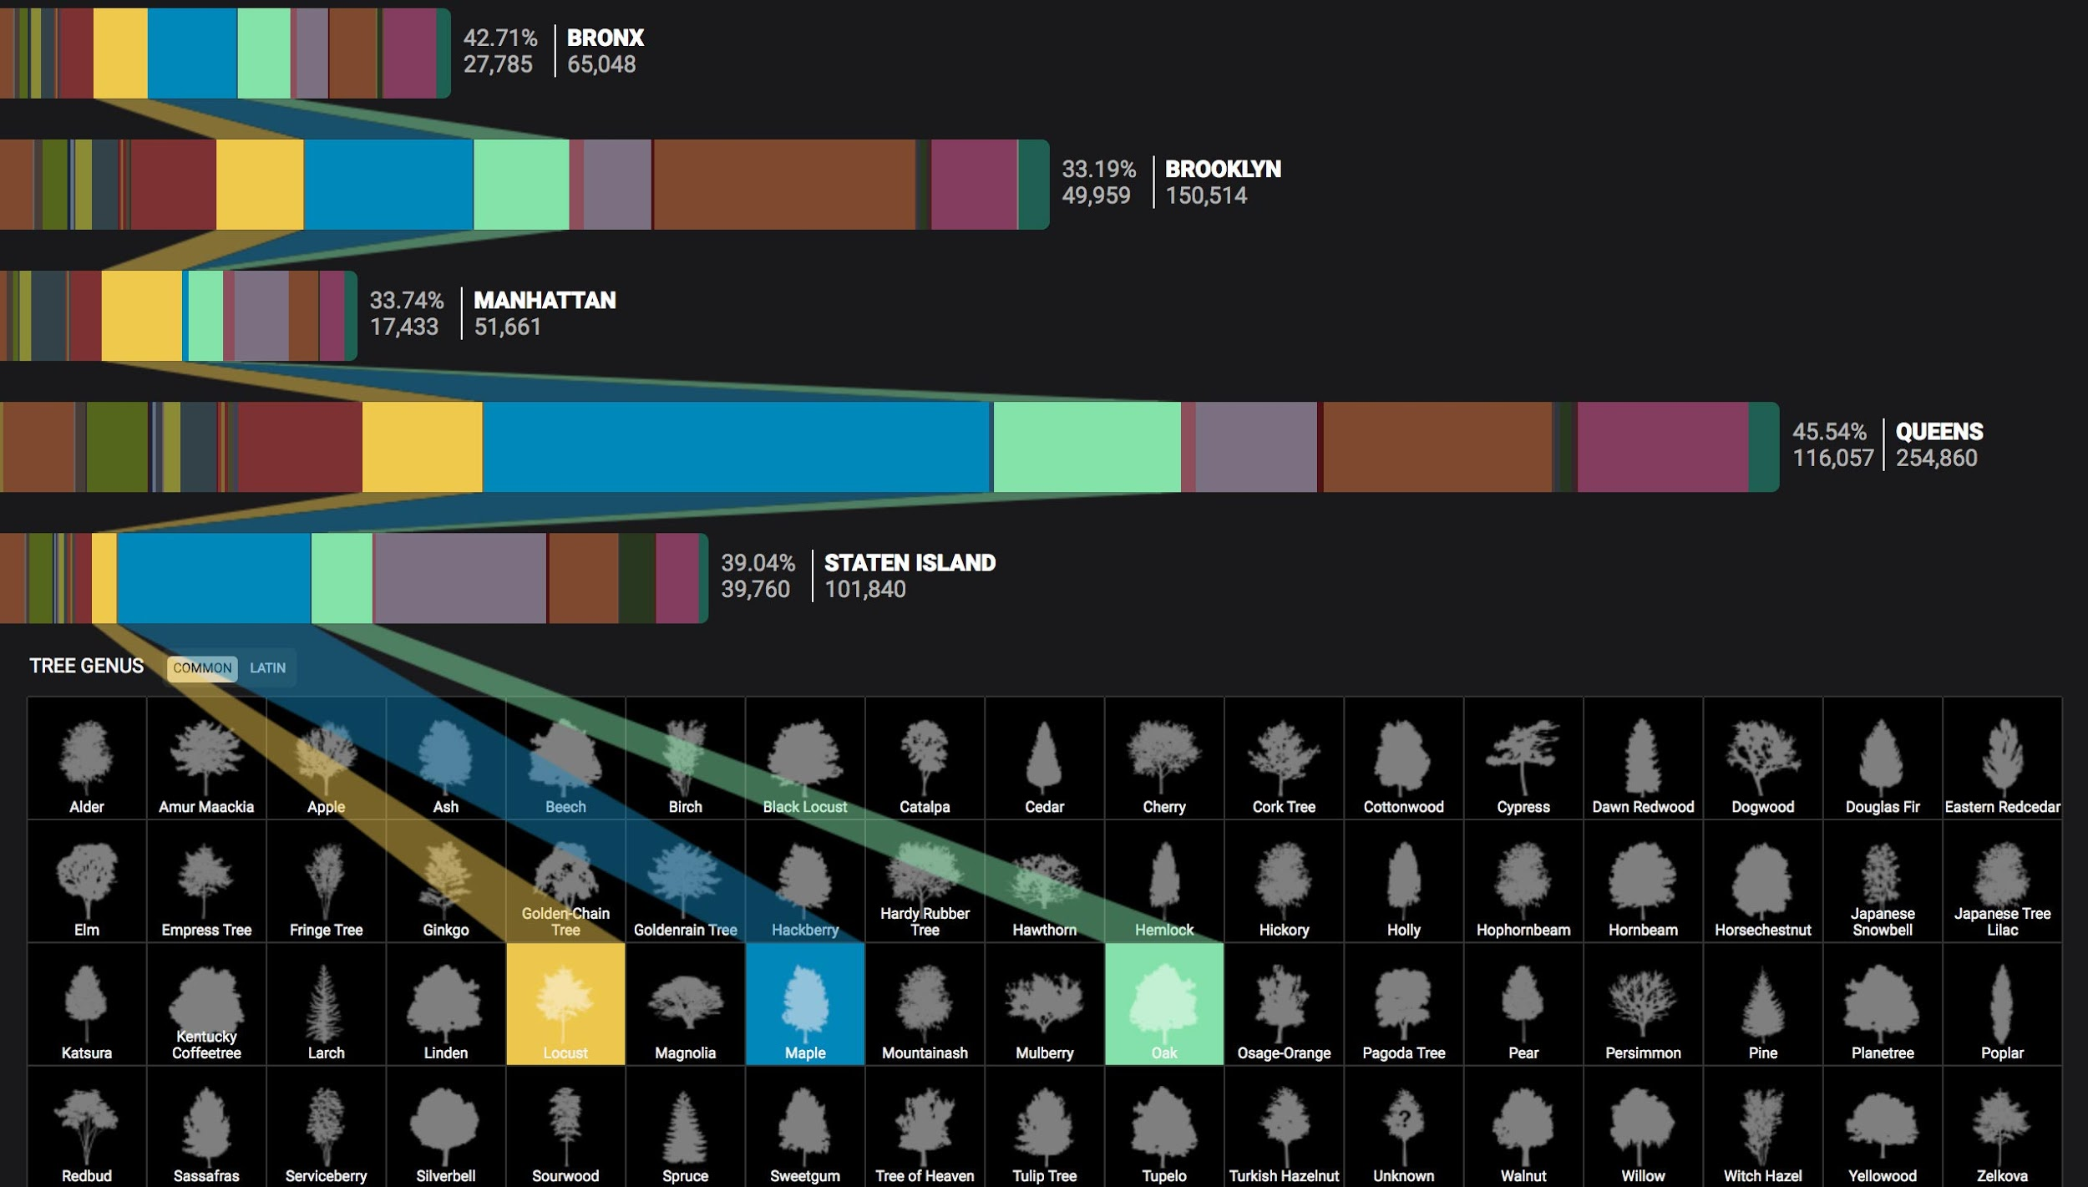
Related Work
Source: cloudred.com/lab/nyctrees

Slide 17
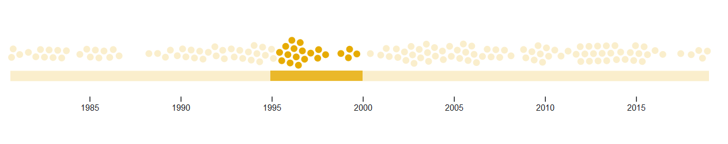
Related Work: Item Vectors as Beeswarms
Source: observablehq.com/@maritrinez/d3-brushable-timeline-beeswarm

Slide 18
Participation
Mike
Abdullah
Daniel
Most of the coding
Gave informal presentation
Group discussions
Worked on code
Gave informal presentation
Group discussions
Wrote proposal & slides
Research & getting original EZChooser to work
Group discussions

